Slide 1
ABAP programming on HANA Native SQL + ADBC + New Open SQL

Slide 2

Agenda
01
02
03
Native SQL
Definition
Samples
ADBC
New Open SQL

Slide 3
SAP Open SQL and Native SQL

Slide 4
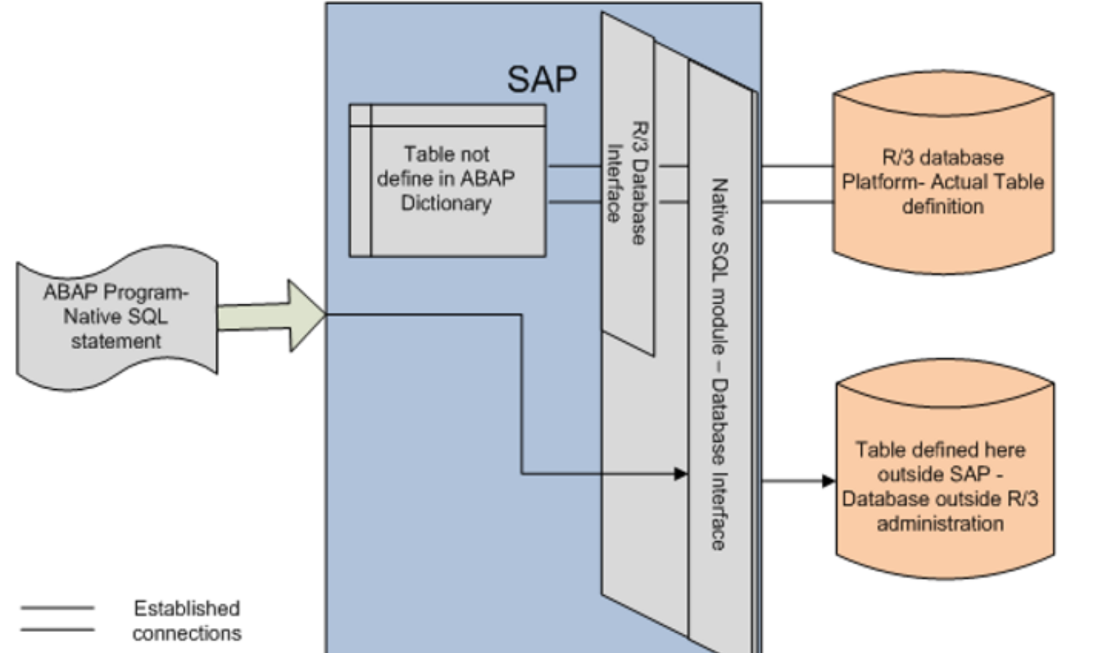
Native SQL

Slide 5
Features of SAP Open SQL & SAP Native SQL
Feature | SAP Native SQL | SAP Open SQL
SQL Type | Database-specific | Database-independent SQL defined by SAP
Access Method | Bypasses ABAP Database Interface Layer | Uses ABAP Database Interface Layer
Compatibility | Not adaptable to all SAP systems | Adaptable to all SAP systems
Access Scope | Can access tables, views, stored procedures, third-party databases | Can only access tables and views created in ABAP Dictionary
Cache Use | Does not use cache | Uses cache
Typical Use Cases | Used for DML, DDL, DCL, modifying database objects directly | Used for DML operations (SELECT, INSERT, UPDATE, DELETE)
Security Risk | Can modify/delete tables, higher security risk | Lower security risk
Database Independence | Depends on the underlying database | Independent of underlying database
Operation Scope | Can operate on objects not managed by ABAP Dictionary | Limited to DML on ABAP Dictionary objects
Notes:
SAP OPEN SQL
The database-independent SQL standard defined by SAP for ABAP provides unified syntax and semantics for all database systems supported by SAP.
The Database Interface layer in ABAP is responsible for dynamically converting Open SQL into local SQL used by the corresponding database at runtime.
ABAPer does not need to consider the differences in databases used by SAP systems when writing programs. The results of operations and any error messages are independent of the database system being used.
ABAP programs developed based on Open SQL can be reused in SAP systems without worrying about the type of underlying database.
Open SQL statements can only access database tables and views created in the ABAP dictionary, and cannot operate on tables created directly through database tools
Open SQL has some functional limitations, that is, only DML of standard SQL has corresponding Open SQL, such as: SELECT, INSERT, UPDATE, DELETE.
SAP NATIVE SQL
Each relational database has its corresponding SQL, which is database-related.
Native SQL bypasses the Database Interface layer in ABAP and directly accesses the Database Interface layer of the database layer without conversion.
Different SAP systems may use different databases. ABAP programs using Native SQL cannot adapt to all SAP systems.
Native SQL can access specific databases through set database links, and can access database objects that are not managed by the ABAP dictionary, such as tables, views, stored procedures, and external third-party database systems.
Native SQL does not use cache and will be sent directly to the database without passing through the ABAP data access layer. In addition to DML, it is generally used for DDL and DCL, which can be used to maintain database objects.
It can directly modify and delete database tables, which has certain security risks.

Slide 6
Native SQL

Slide 7
Notes and precautions
After SAP is upgraded to S4, only SAP HANA database is supported. In theory, HANA database is backward compatible, so ABAP programs based on Hana's Native SQL are also reusable.
Native SQL will not filter the current client number by default like Open SQL, and all statements need to be specified by yourself.

Slide 8
Native SQL (Exec SQL)
EXEC SQL
[ PERFORMING <form_routine> ].
<native_sql_statements>
ENDEXEC.

Slide 9
Get a single record
DATA: lv_count TYPE i.
EXEC SQL.
select count(1) into :lv_count
from saphanadb.scarr
where mandt = :sy-mandt ;
ENDEXEC.
WRITE:/ lv_count.

Slide 10
Get multiple rows
DATA: lv_carrid TYPE scarr-carrid,
lv_carrname TYPE scarr-carrname.
EXEC SQL PERFORMING Write_data.
select carrid, carrname into :lv_carrid,:lv_carrname
from saphanadb.scarr
where mandt = :sy-mandt ;
ENDEXEC.
FORM Write_data.
WRITE:/ lv_carrid,'',lv_carrname.
ENDFORM.

Slide 11
Cursor Application
DATA: BEGIN OF gs_scarr,
carrid TYPE scarr-carrid,
carrname TYPE scarr-carrname,
END OF gs_scarr.
EXEC SQL.
OPEN cursor FOR
select carrid, carrname
from saphanadb.scarr
where mandt = :sy-mandt
ENDEXEC.
DO.
CLEAR gs_scarr.
EXEC SQL.
FETCH NEXT cursor INTO :gs_scarr
ENDEXEC.
IF sy-subrc <> 0.
EXIT.
ELSE.
WRITE:/ gs_scarr-carrid,‘’,
gs_scarr-carrname.
ENDIF.
ENDDO.
EXEC SQL.
CLOSE cursor
ENDEXEC.

Slide 12
Exception Handling
DATA lv_store_dbs TYPE dbcon-con_name.
DATA: lv_exc_ref TYPE REF TO cx_sy_native_sql_error,
lv_error_text TYPE string.
TRY.
EXEC SQL.
CONNECT TO :lv_store_dbs
ENDEXEC.
IF sy-subrc <> 0.
RAISE EXCEPTION TYPE cx_sy_native_sql_error.
ENDIF.
CATCH cx_sy_native_sql_error INTO lv_exc_ref.
CLEAR: lv_error_text.
lv_error_text = lv_exc_ref->get_text( ).
MESSAGE lv_error_text TYPE 'I'.
ENDTRY.

Slide 13
Executing DDL Statements
DATA: lv_count TYPE i.
DATA: lv_exc_ref TYPE REF TO cx_sy_native_sql_error,
lv_error_text TYPE string.
TRY.
EXEC SQL.
drop table zemployee
ENDEXEC.
IF sy-subrc <> 0.
RAISE EXCEPTION TYPE cx_sy_native_sql_error.
ENDIF.
EXEC SQL.
create table zemployee
(
no int,
name nvarchar(10),
sex nvarchar(1),
age int,
primary key (ZNo)
);
ENDEXEC.
IF sy-subrc <> 0.
RAISE EXCEPTION TYPE cx_sy_native_sql_error.
ENDIF.

Slide 14
ADBC
ABAP Database Connectivity

Slide 15
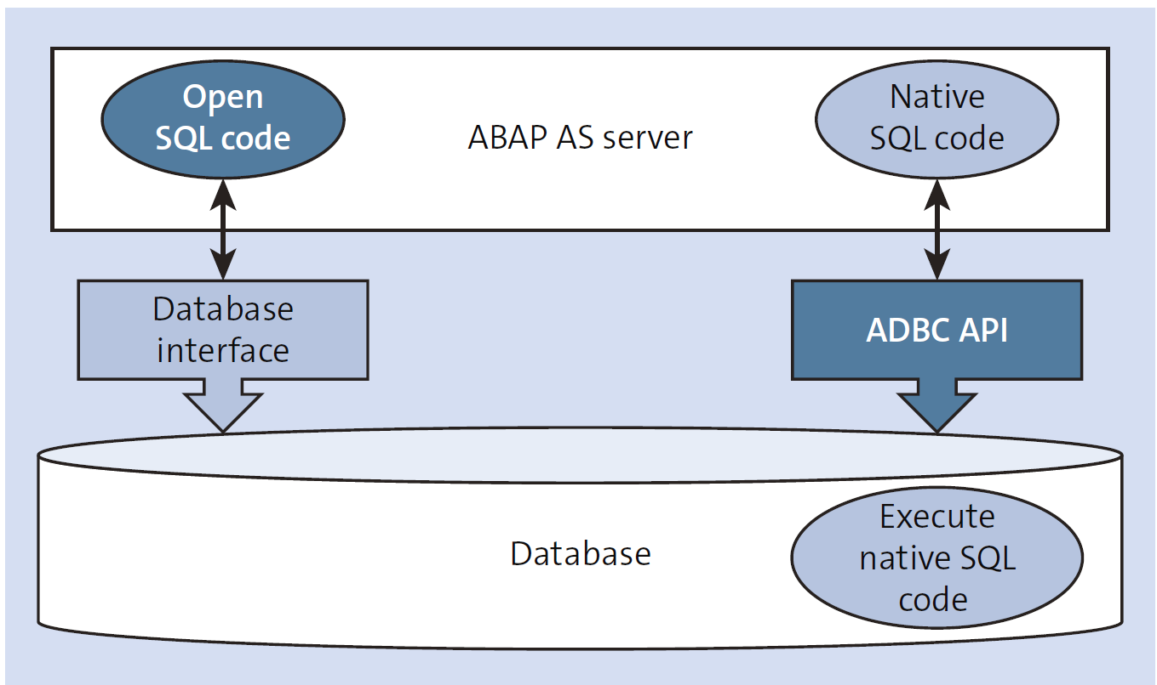
ABAP Database Connectivity

Slide 16
Native SQL vs ADBC in ABAP
Native SQL Overview
Direct database-specific SQL execution in ABAP.
Bypasses SAP Open SQL layer.
Flexible but dependent on the database system (e.g., HANA, Oracle).
Allows use of database-specific features not supported by Open SQL.
Use Cases:
When leveraging specific database features for performance.
Executing complex SQL queries that Open SQL cannot handle.
ADBC Overview
ABAP Database Connectivity introduced in ABAP 7.02.
Enables dynamic SQL execution and database interaction via ABAP classes.
More flexible than Open SQL, with dynamic SQL query support.
Provides cross-database compatibility and SQL execution without database-specific syntax.
Use Cases:
When building dynamic SQL queries based on runtime conditions.
Handling large result sets or complex queries in a database-independent manner.
Database-dependent.
Direct access to advanced features of specific databases.
Best for highly specialized queries and performance optimization.
Database-agnostic.
More flexible for dynamic SQL execution.
Ideal for cross-database compatibility and dynamic query scenarios.

Slide 17
Class Methods ADBC
The essence of ADBC ​​(ABAP Database Connectivity) is Native SQL, which is just encapsulated by classes. It is more in line with the object-oriented development concept and is relatively more friendly to development.
SAP provides you with a Native SQL interface API, which is mainly composed of 4 classes:
CL_SQL_STATEMENT - Execution of SQL Statements
CL_SQL_PREPARED_STATEMENT - Prepared SQL Statements
CL_SQL_CONNECTION - Administration of Database Connections
CX_SQL_EXCEPTION - Exception Class

Slide 18
Querying the Database
Interaction with any database requires four basic steps, which also apply when using ABAP database connectivity in SAP NetWeaver AS ABAP to connect to SAP HANA:
Connecting to the database
Preparing the SQL query to retrieve the result set
Executing the query
Getting the result set

Slide 19
Connect to the Database
The first step is to prepare the connection to the database by class CL_SQL_CONNECTION / METHOD GET_CONNECTION,
as shown in the following:
DATA: lo_sql_conn TYPE REF TO cl_sql_connection,
TRY .
lo_sql_conn =cl_sql_connection=>get_connection( ).
CATCH cx_sql_exception.
ENDTRY.
說明時，請從設計原理方向介紹！

Slide 20
Preparing the Query
*Convert selection option to a where clause string
DATA(lo_seltab) = cl_lib_seltab=>new( it_sel = s_carrid[] ).
DATA(lv_where_clause_sel) = lo_seltab->sql_where_condition( iv_field = 'CARRID' ).
lv_statement = | SELECT |
&& |carrid,| && |connid,| && |fldate,| && |price,| && |currency|
&& |FROM sflight|
&& |WHERE mandt = '{ sy-mandt }’|
&& |AND '{ lv_where_clause_sel }'|.
說明時，請從設計原理方向介紹！

Slide 21
Executing the Query
TRY .
*Prepare Connection
lo_sql_conn =cl_sql_connection=>get_connection( ).
*Prepare the SQLStatement
lo_sql_stmt =lo_sql_conn->create_statement( ).
lo_sql_result =lo_sql_stmt->execute_query( lv_statement).
CATCH cx_sql_exception .
ENDTRY.
說明時，請從設計原理方向介紹！

Slide 22
Retrieving Results
TRY .
*Prepare Connection
lo_sql_conn = cl_sql_connection=>get_connection( ).
*Prepare the SQLStatement
lo_sql_stmt = lo_sql_conn->create_statement( ).
lo_sql_result = lo_sql_stmt->execute_query( lv_statement ).
*Pass resultset to the ref of the internal table to be displayed
lo_sql_result->set_param_table( lr_data ).
CATCH cx_sql_exception .
ENDTRY.
說明時，請從設計原理方向介紹！

Slide 23
New Open SQL

Slide 24

Classical Open SQL and Its Limitation
Open SQL in ABAP < 7.4 SPS05 does not support everything possible with standard SQL DML or SAP HANA SQL
Standard SQL DML:
Fixed-value and computed columns
Sub-queries in the SELECT or FROM clauses
UNIONs
CASE expression
Additional Join types
HANA SQL:
Using HANA built-in functions, e.g., DAYS_BETWEEN( )
Accessing HANA Views
New Open SQL & Core Data Services in ABAP 7.4 SP05 support more

Slide 25

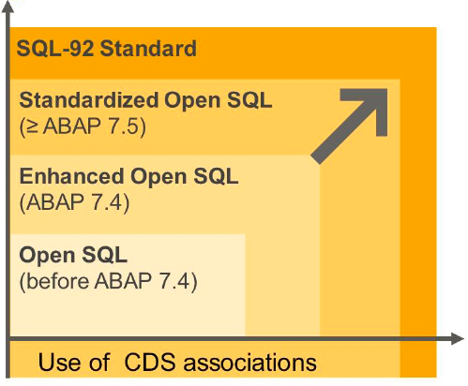
New Open SQL
Open SQL is the only DB abstraction layer that defines a common semantic for all
SAP supported databases
Limitations in ABAP < 7.4 SP05:
No expressions
Limited JOIN types
No UNION and UNION ALL
Additional restrictions
Minimize the limitations:
Support more standard SQL features in Open SQL – for SAP HANA and other database platforms

Slide 26
New Open SQL
New Open SQL syntax:
ABAP variables escaped with “@”
Comma-separated column list
Arithmetic expressions using +, -, *, /, DIV, MOD, ABS, FLOOR, CEIL
Common semantics
String concatenation
SQL CASE, COALESCE
Implication:
Strict mode: Nearly all former warnings transform into syntax errors.
SELECT carrid, connid, fldate, bookid, customid
FROM sbook
INTO TABLE @lt_bookings
WHERE customid = @lv_customer.
SELECT carrid, connid, fldate, bookid, customid, CASE smoker WHEN 'X' THEN FLOOR( loccuram * @lc_smoker_fee ) ELSE
CEIL( loccuram * @lc_nonsm_disc ) END AS adjusted_amount, CAST( loccuram AS FLTP ) / CAST( 2 AS FLTP ) AS half, loccurkey FROM sbook INTO TABLE @lt_bookings2 WHERE customid = @lv_customer.

Slide 27
New Open SQL
INTO clause at the end:
For consistency with UNION syntax
Additions such as UP TO ... ROWS after INTO
SELECT carrid, connid, fldate, bookid, customid
FROM sbook
WHERE customid = @lv_customer
INTO TABLE @lt_bookings UP TO 10 ROWS.
Keyword FIELDS:
Exchange order of field list and FROM clause
FROM clause first results in code-completion friendly syntax
SELECT FROM sbook
FIELDS carrid, connid, fldate, bookid, customid
WHERE customid = @lv_customer
INTO TABLE @lt_bookings UP TO 10 ROWS.

Slide 28
New Open SQL
Support for UNION and UNION ALL:
Only explicit field lists allowed – no *
INTO clause must be at the end
SELECT FROM sbook
FIELDS carrid, connid, fldate, bookid, customid,
FLOOR( loccuram * @lc_smoker_fee ) AS smoker_fee,
CAST( loccuram AS FLTP ) / CAST( 2 AS FLTP ) AS half,
loccurkey
WHERE customid = @lv_customer
AND smoker = 'X'
UNION ALL
SELECT FROM sbook
FIELDS carrid, connid, fldate, bookid, customid,
CEIL( loccuram * @lc_nonsm_disc ) AS nonsm_disc,
CAST( loccuram AS FLTP ) / CAST( 2 AS FLTP ) AS half,
loccurkey
WHERE customid = @lv_customer
AND smoker = ' '
INTO TABLE @lt_bookings2.

Slide 29
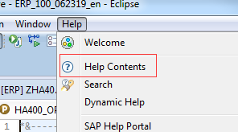
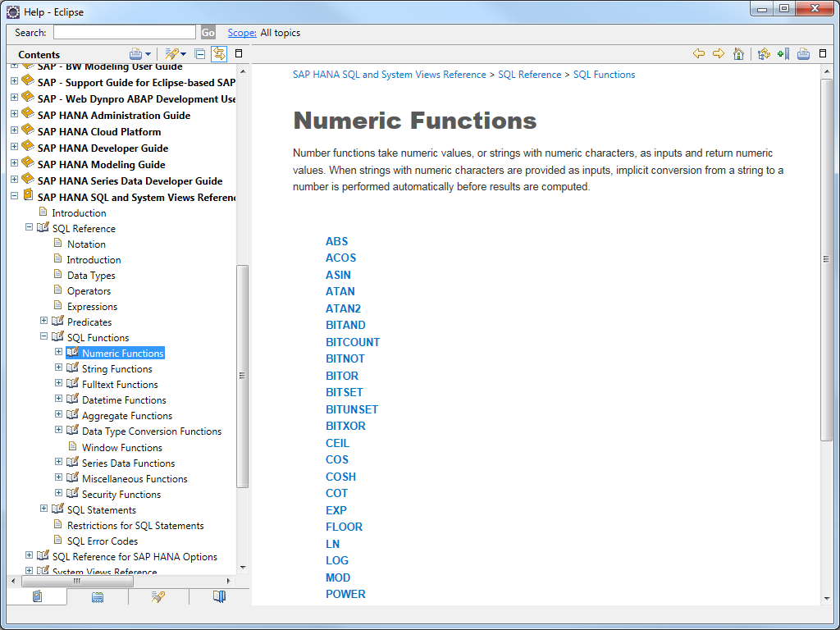
Hana SQL reference

Slide 30
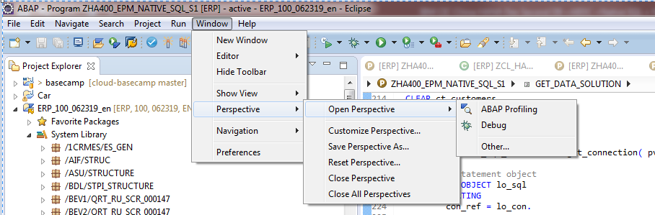
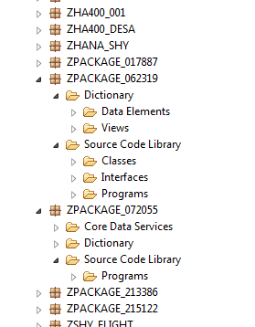
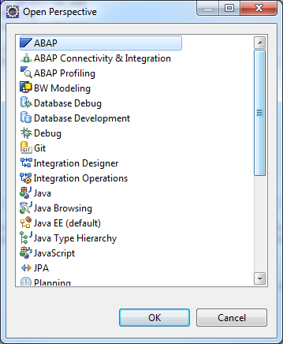
Exercise: Open ABAP Perspective

Slide 31
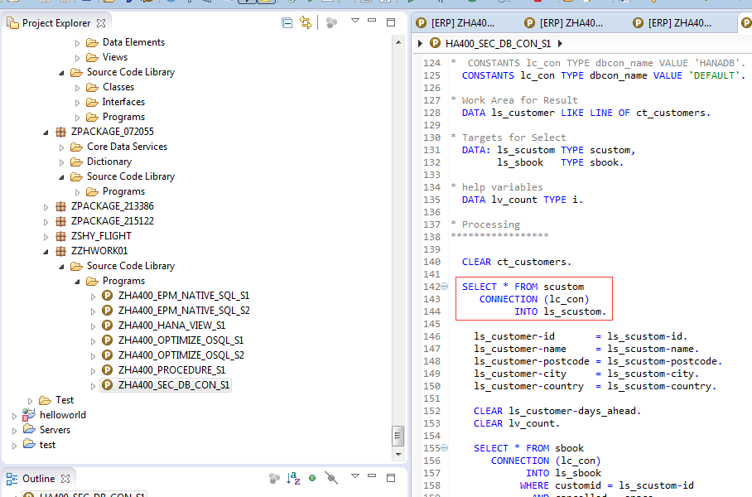
Exercise: Secondary DB connection

Slide 32
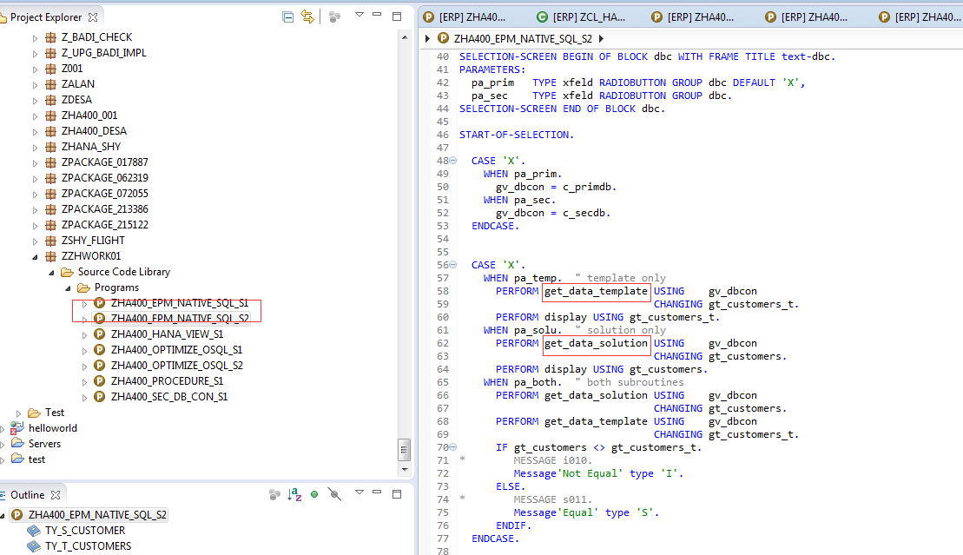
Exercise: ADBC and Native SQL

Slide 33
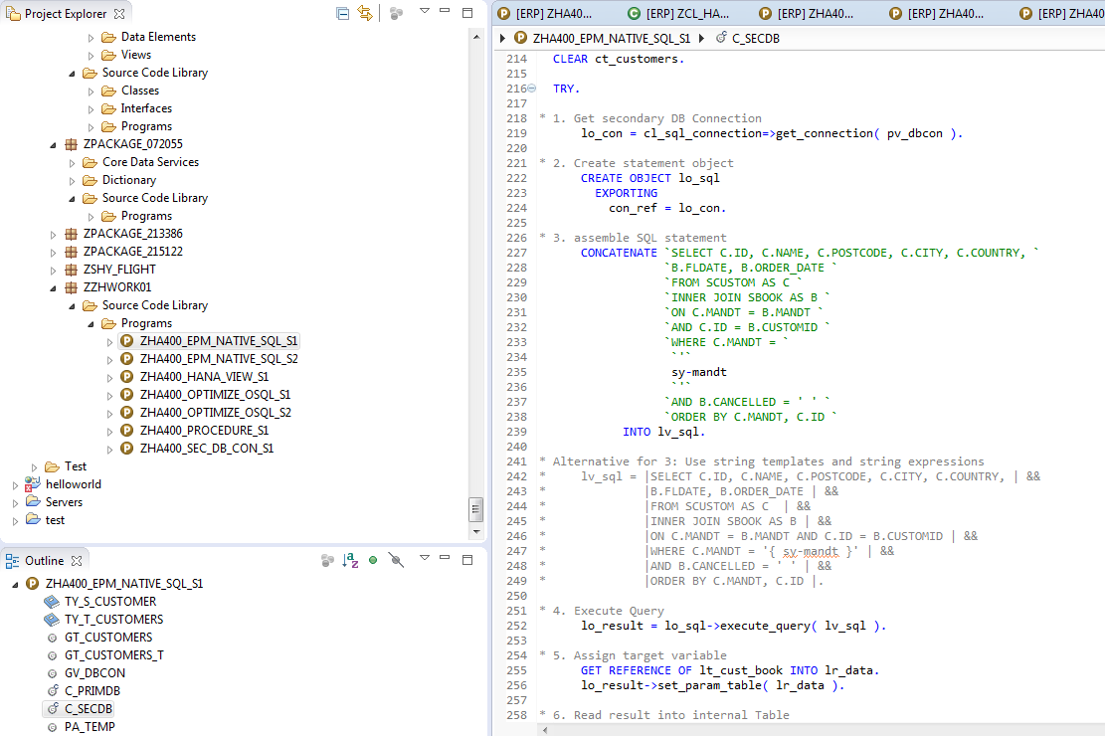
Exercise: ADBC and Native SQL

Slide 34
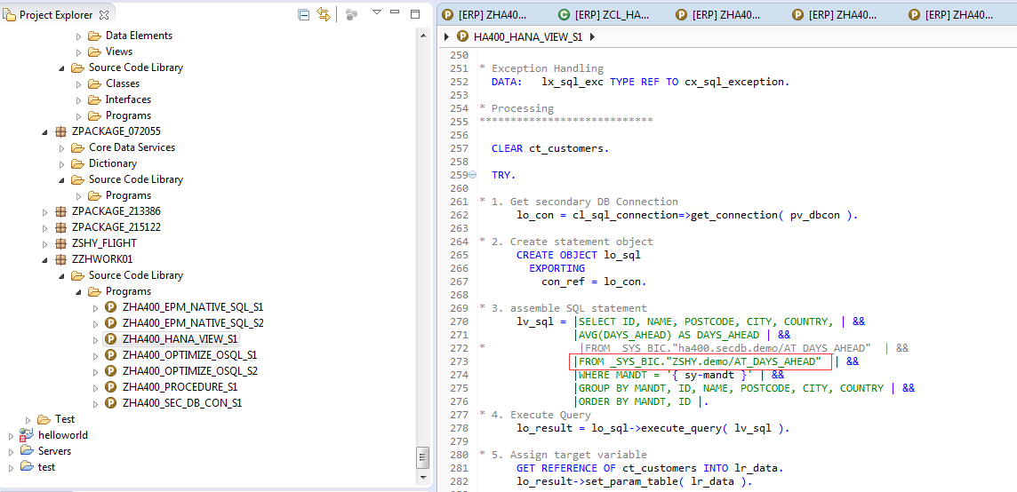
Exercise: Consume Hana view
Notes:
*&---------------------------------------------------------------------*
*& Report HA400_HANA_VIEW_S1
*&
*&---------------------------------------------------------------------*
*&
*&
*&---------------------------------------------------------------------*
REPORT ha400_hana_view_s1 MESSAGE-ID ha400.
* Structure for Result
TYPES: BEGIN OF ty_s_customer,
id TYPE scustom-id,
name TYPE scustom-name,
postcode TYPE scustom-postcode,
city TYPE scustom-city,
country TYPE scustom-country,
days_ahead TYPE zha400_avgnd,
END OF ty_s_customer.
TYPES: ty_t_customers TYPE STANDARD TABLE OF ty_s_customer
WITH NON-UNIQUE KEY id name.
* Data objects
DATA: gt_customers TYPE ty_t_customers,
gt_customers_t LIKE gt_customers.
* Database connection
DATA gv_dbcon TYPE dbcon-con_name.
CONSTANTS:
c_primdb TYPE dbcon-con_name VALUE 'DEFAULT',
* c_secdb TYPE dbcon-con_name VALUE 'HANADB'.
c_secdb TYPE dbcon-con_name VALUE 'DEFAULT'.
* selection screen
SELECTION-SCREEN BEGIN OF BLOCK exe WITH FRAME TITLE text-exe.
PARAMETERS:
pa_temp TYPE xfeld RADIOBUTTON GROUP exe,
pa_solu TYPE xfeld RADIOBUTTON GROUP exe DEFAULT 'X',
pa_both TYPE xfeld RADIOBUTTON GROUP exe.
SELECTION-SCREEN END OF BLOCK exe.
SELECTION-SCREEN BEGIN OF BLOCK dbc WITH FRAME TITLE text-dbc.
PARAMETERS:
pa_prim TYPE xfeld RADIOBUTTON GROUP dbc DEFAULT 'X',
pa_sec TYPE xfeld RADIOBUTTON GROUP dbc.
SELECTION-SCREEN END OF BLOCK dbc.
INITIALIZATION.
LOOP AT SCREEN.
IF screen-name = 'PA_SEC' OR screen-name = 'PA_PRIM'.
screen-input = abap_false.
MODIFY SCREEN.
ENDIF.
ENDLOOP.
START-OF-SELECTION.
CASE 'X'.
WHEN pa_prim.
gv_dbcon = c_primdb.
WHEN pa_sec.
gv_dbcon = c_secdb.
ENDCASE.
CASE 'X'.
WHEN pa_temp. " template only
PERFORM get_data_template USING gv_dbcon
CHANGING gt_customers_t.
PERFORM display USING gt_customers_t.
WHEN pa_solu. " solution only
PERFORM get_data_solution USING gv_dbcon
CHANGING gt_customers.
PERFORM display USING gt_customers.
WHEN pa_both. " both subroutines
PERFORM get_data_solution USING gv_dbcon
CHANGING gt_customers.
PERFORM get_data_template USING gv_dbcon
CHANGING gt_customers_t.
IF gt_customers <> gt_customers_t.
MESSAGE i010.
ELSE.
MESSAGE s011.
ENDIF.
ENDCASE.
*&---------------------------------------------------------------------*
*& Form get_data_template
*&---------------------------------------------------------------------*
FORM get_data_template USING pv_dbcon TYPE dbcon-con_name
CHANGING ct_customers TYPE ty_t_customers.
* Declarations
****************
* Types for target fields
TYPES: BEGIN OF lty_s_cust_book,
id TYPE scustom-id,
name TYPE scustom-name,
postcode TYPE scustom-postcode,
city TYPE scustom-city,
country TYPE scustom-country,
fldate TYPE sbook-fldate,
order_date TYPE sbook-order_date,
END OF lty_s_cust_book.
* Work Area for Result
DATA ls_customer LIKE LINE OF ct_customers.
* Targets for Select
* DATA: lt_cust_book TYPE SORTED TABLE OF lty_s_cust_book
* WITH NON-UNIQUE KEY id,
* sorted table not supported by ADBC!
DATA: lt_cust_book TYPE STANDARD TABLE OF lty_s_cust_book
WITH NON-UNIQUE KEY id,
ls_cust_book TYPE lty_s_cust_book.
* help variables
DATA lv_count TYPE i.
* ADBC Objects and Variables
DATA: lo_con TYPE REF TO cl_sql_connection,
lo_sql TYPE REF TO cl_sql_statement,
lo_result TYPE REF TO cl_sql_result_set,
lv_sql TYPE string,
lr_data TYPE REF TO data.
* Exception Handling
DATA: lx_sql_exc TYPE REF TO cx_sql_exception.
* Processing
****************************
CLEAR ct_customers.
TRY.
* 1. Get secondary DB Connection
lo_con = cl_sql_connection=>get_connection( pv_dbcon ).
* 2. Create statement object
CREATE OBJECT lo_sql
EXPORTING
con_ref = lo_con.
* 3. assemble SQL statement
CONCATENATE `SELECT C.ID, C.NAME, C.POSTCODE, C.CITY, C.COUNTRY, `
`B.FLDATE, B.ORDER_DATE `
`FROM SCUSTOM AS C `
`INNER JOIN SBOOK AS B `
`ON C.MANDT = B.MANDT `
`AND C.ID = B.CUSTOMID `
`WHERE C.MANDT = `
`'`
sy-mandt
`'`
`AND B.CANCELLED = ' ' `
`ORDER BY C.MANDT, C.ID `
INTO lv_sql.
* Alternative for 3: Use string templates and string expressions
* lv_sql = |SELECT C.ID, C.NAME, C.POSTCODE, C.CITY, C.COUNTRY | &&
* |B.FLDATE, B.ORDER_DATE | &&
* |FROM SCUSTOM AS C | &&
* |INNER JOIN SBOOK AS B | &&
* |ON C.MANDT = B.MANDT AND C.ID = B.CUSTOMID | &&
* |WHERE C.MANDT = '{ sy-mandt }' | &&
* |AND B.CANCELLED = ' ' | &&
* |ORDER BY C.MANDT, C.ID |.
* 4. Execute Query
lo_result = lo_sql->execute_query( lv_sql ).
* 5. Assign target variable
GET REFERENCE OF lt_cust_book INTO lr_data.
lo_result->set_param_table( lr_data ).
* 6. Read result into internal Table
lo_result->next_package( ).
* 7. Close connection
lo_result->close( ).
* Exception handling
CATCH cx_sql_exception INTO lx_sql_exc. "Excpt. Class for SQL Error
MESSAGE lx_sql_exc TYPE 'E'.
ENDTRY.
LOOP AT lt_cust_book INTO ls_cust_book.
IF sy-tabix = 1.
ls_customer-id = ls_cust_book-id.
ls_customer-name = ls_cust_book-name.
ls_customer-postcode = ls_cust_book-postcode.
ls_customer-city = ls_cust_book-city.
ls_customer-country = ls_cust_book-country.
ELSEIF ls_cust_book-id <> ls_customer-id.
ls_customer-days_ahead =
round( val = ls_customer-days_ahead / lv_count
dec = 4
mode = cl_abap_math=>round_down ).
INSERT ls_customer INTO TABLE ct_customers.
CLEAR ls_customer.
CLEAR lv_count.
ls_customer-id = ls_cust_book-id.
ls_customer-name = ls_cust_book-name.
ls_customer-postcode = ls_cust_book-postcode.
ls_customer-city = ls_cust_book-city.
ls_customer-country = ls_cust_book-country.
ENDIF.
lv_count = lv_count + 1.
ls_customer-days_ahead = ls_customer-days_ahead
+ ls_cust_book-fldate
- ls_cust_book-order_date.
ENDLOOP.
ls_customer-days_ahead =
round( val = ls_customer-days_ahead / lv_count
dec = 4
mode = cl_abap_math=>round_down ).
INSERT ls_customer INTO TABLE ct_customers.
* SORT ct_customers BY id. "already sorted
ENDFORM. "
*&---------------------------------------------------------------------*
*& Form get_data_solution
*&---------------------------------------------------------------------*
FORM get_data_solution USING pv_dbcon TYPE dbcon-con_name
CHANGING ct_customers TYPE ty_t_customers.
* Declarations
****************
* ADBC Objects and Variables
DATA: lo_con TYPE REF TO cl_sql_connection,
lo_sql TYPE REF TO cl_sql_statement,
lo_result TYPE REF TO cl_sql_result_set,
lv_sql TYPE string,
lr_data TYPE REF TO data.
* Exception Handling
DATA: lx_sql_exc TYPE REF TO cx_sql_exception.
* Processing
****************************
CLEAR ct_customers.
TRY.
* 1. Get secondary DB Connection
lo_con = cl_sql_connection=>get_connection( pv_dbcon ).
* 2. Create statement object
CREATE OBJECT lo_sql
EXPORTING
con_ref = lo_con.
* 3. assemble SQL statement
lv_sql = |SELECT ID, NAME, POSTCODE, CITY, COUNTRY, | &&
|AVG(DAYS_AHEAD) AS DAYS_AHEAD | &&
* |FROM _SYS_BIC."ha400.secdb.demo/AT_DAYS_AHEAD" | &&
|FROM _SYS_BIC."ZSHY.demo/AT_DAYS_AHEAD" | &&
|WHERE MANDT = '{ sy-mandt }' | &&
|GROUP BY MANDT, ID, NAME, POSTCODE, CITY, COUNTRY | &&
|ORDER BY MANDT, ID |.
* 4. Execute Query
lo_result = lo_sql->execute_query( lv_sql ).
* 5. Assign target variable
GET REFERENCE OF ct_customers INTO lr_data.
lo_result->set_param_table( lr_data ).
* 6. Read result into internal Table
lo_result->next_package( ).
* 7. Close connection
lo_result->close( ).
* Exception handling
CATCH cx_sql_exception INTO lx_sql_exc. "Excpt. Class for SQL Error
MESSAGE lx_sql_exc TYPE 'E'.
ENDTRY.
ENDFORM. "
*&---------------------------------------------------------------------*
*& Form output
*&---------------------------------------------------------------------*
FORM display USING pt_customers TYPE ty_t_customers.
DATA: lo_alv TYPE REF TO cl_salv_table,
lx_msg TYPE REF TO cx_salv_msg,
lv_text TYPE string.
* display
TRY.
cl_salv_table=>factory(
IMPORTING
r_salv_table = lo_alv
CHANGING
t_table = pt_customers ).
lo_alv->display( ).
CATCH cx_salv_msg INTO lx_msg.
lv_text = lx_msg->get_text( ).
MESSAGE lv_text TYPE 'E'.
ENDTRY.
ENDFORM. "display

Slide 35
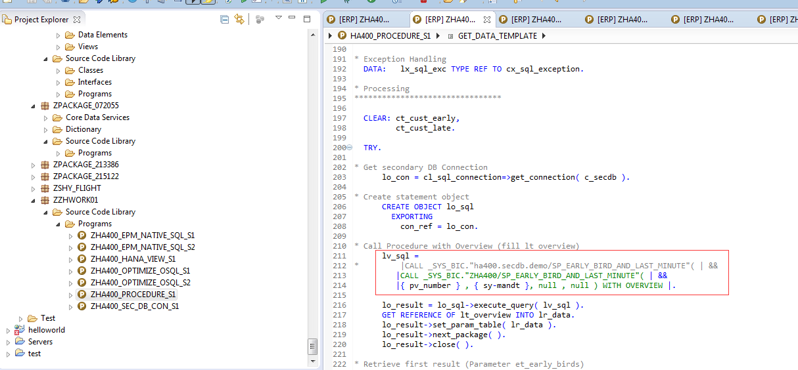
Exercise: call procedure
Notes:
*&---------------------------------------------------------------------*
*& Report HA400_HANA_VIEW_S1
*&
*&---------------------------------------------------------------------*
*&
*&
*&---------------------------------------------------------------------*
REPORT ha400_hana_view_s1 MESSAGE-ID ha400.
* Structure for Result
TYPES: BEGIN OF ty_s_customer,
id TYPE scustom-id,
name TYPE scustom-name,
postcode TYPE scustom-postcode,
city TYPE scustom-city,
country TYPE scustom-country,
days_ahead TYPE zha400_avgnd,
END OF ty_s_customer.
TYPES: ty_t_customers TYPE STANDARD TABLE OF ty_s_customer
WITH NON-UNIQUE KEY id name.
* Data objects
DATA: gt_customers TYPE ty_t_customers,
gt_customers_t LIKE gt_customers.
* Database connection
DATA gv_dbcon TYPE dbcon-con_name.
CONSTANTS:
c_primdb TYPE dbcon-con_name VALUE 'DEFAULT',
* c_secdb TYPE dbcon-con_name VALUE 'HANADB'.
c_secdb TYPE dbcon-con_name VALUE 'DEFAULT'.
* selection screen
SELECTION-SCREEN BEGIN OF BLOCK exe WITH FRAME TITLE text-exe.
PARAMETERS:
pa_temp TYPE xfeld RADIOBUTTON GROUP exe,
pa_solu TYPE xfeld RADIOBUTTON GROUP exe DEFAULT 'X',
pa_both TYPE xfeld RADIOBUTTON GROUP exe.
SELECTION-SCREEN END OF BLOCK exe.
SELECTION-SCREEN BEGIN OF BLOCK dbc WITH FRAME TITLE text-dbc.
PARAMETERS:
pa_prim TYPE xfeld RADIOBUTTON GROUP dbc DEFAULT 'X',
pa_sec TYPE xfeld RADIOBUTTON GROUP dbc.
SELECTION-SCREEN END OF BLOCK dbc.
INITIALIZATION.
LOOP AT SCREEN.
IF screen-name = 'PA_SEC' OR screen-name = 'PA_PRIM'.
screen-input = abap_false.
MODIFY SCREEN.
ENDIF.
ENDLOOP.
START-OF-SELECTION.
CASE 'X'.
WHEN pa_prim.
gv_dbcon = c_primdb.
WHEN pa_sec.
gv_dbcon = c_secdb.
ENDCASE.
CASE 'X'.
WHEN pa_temp. " template only
PERFORM get_data_template USING gv_dbcon
CHANGING gt_customers_t.
PERFORM display USING gt_customers_t.
WHEN pa_solu. " solution only
PERFORM get_data_solution USING gv_dbcon
CHANGING gt_customers.
PERFORM display USING gt_customers.
WHEN pa_both. " both subroutines
PERFORM get_data_solution USING gv_dbcon
CHANGING gt_customers.
PERFORM get_data_template USING gv_dbcon
CHANGING gt_customers_t.
IF gt_customers <> gt_customers_t.
MESSAGE i010.
ELSE.
MESSAGE s011.
ENDIF.
ENDCASE.
*&---------------------------------------------------------------------*
*& Form get_data_template
*&---------------------------------------------------------------------*
FORM get_data_template USING pv_dbcon TYPE dbcon-con_name
CHANGING ct_customers TYPE ty_t_customers.
* Declarations
****************
* Types for target fields
TYPES: BEGIN OF lty_s_cust_book,
id TYPE scustom-id,
name TYPE scustom-name,
postcode TYPE scustom-postcode,
city TYPE scustom-city,
country TYPE scustom-country,
fldate TYPE sbook-fldate,
order_date TYPE sbook-order_date,
END OF lty_s_cust_book.
* Work Area for Result
DATA ls_customer LIKE LINE OF ct_customers.
* Targets for Select
* DATA: lt_cust_book TYPE SORTED TABLE OF lty_s_cust_book
* WITH NON-UNIQUE KEY id,
* sorted table not supported by ADBC!
DATA: lt_cust_book TYPE STANDARD TABLE OF lty_s_cust_book
WITH NON-UNIQUE KEY id,
ls_cust_book TYPE lty_s_cust_book.
* help variables
DATA lv_count TYPE i.
* ADBC Objects and Variables
DATA: lo_con TYPE REF TO cl_sql_connection,
lo_sql TYPE REF TO cl_sql_statement,
lo_result TYPE REF TO cl_sql_result_set,
lv_sql TYPE string,
lr_data TYPE REF TO data.
* Exception Handling
DATA: lx_sql_exc TYPE REF TO cx_sql_exception.
* Processing
****************************
CLEAR ct_customers.
TRY.
* 1. Get secondary DB Connection
lo_con = cl_sql_connection=>get_connection( pv_dbcon ).
* 2. Create statement object
CREATE OBJECT lo_sql
EXPORTING
con_ref = lo_con.
* 3. assemble SQL statement
CONCATENATE `SELECT C.ID, C.NAME, C.POSTCODE, C.CITY, C.COUNTRY, `
`B.FLDATE, B.ORDER_DATE `
`FROM SCUSTOM AS C `
`INNER JOIN SBOOK AS B `
`ON C.MANDT = B.MANDT `
`AND C.ID = B.CUSTOMID `
`WHERE C.MANDT = `
`'`
sy-mandt
`'`
`AND B.CANCELLED = ' ' `
`ORDER BY C.MANDT, C.ID `
INTO lv_sql.
* Alternative for 3: Use string templates and string expressions
* lv_sql = |SELECT C.ID, C.NAME, C.POSTCODE, C.CITY, C.COUNTRY | &&
* |B.FLDATE, B.ORDER_DATE | &&
* |FROM SCUSTOM AS C | &&
* |INNER JOIN SBOOK AS B | &&
* |ON C.MANDT = B.MANDT AND C.ID = B.CUSTOMID | &&
* |WHERE C.MANDT = '{ sy-mandt }' | &&
* |AND B.CANCELLED = ' ' | &&
* |ORDER BY C.MANDT, C.ID |.
* 4. Execute Query
lo_result = lo_sql->execute_query( lv_sql ).
* 5. Assign target variable
GET REFERENCE OF lt_cust_book INTO lr_data.
lo_result->set_param_table( lr_data ).
* 6. Read result into internal Table
lo_result->next_package( ).
* 7. Close connection
lo_result->close( ).
* Exception handling
CATCH cx_sql_exception INTO lx_sql_exc. "Excpt. Class for SQL Error
MESSAGE lx_sql_exc TYPE 'E'.
ENDTRY.
LOOP AT lt_cust_book INTO ls_cust_book.
IF sy-tabix = 1.
ls_customer-id = ls_cust_book-id.
ls_customer-name = ls_cust_book-name.
ls_customer-postcode = ls_cust_book-postcode.
ls_customer-city = ls_cust_book-city.
ls_customer-country = ls_cust_book-country.
ELSEIF ls_cust_book-id <> ls_customer-id.
ls_customer-days_ahead =
round( val = ls_customer-days_ahead / lv_count
dec = 4
mode = cl_abap_math=>round_down ).
INSERT ls_customer INTO TABLE ct_customers.
CLEAR ls_customer.
CLEAR lv_count.
ls_customer-id = ls_cust_book-id.
ls_customer-name = ls_cust_book-name.
ls_customer-postcode = ls_cust_book-postcode.
ls_customer-city = ls_cust_book-city.
ls_customer-country = ls_cust_book-country.
ENDIF.
lv_count = lv_count + 1.
ls_customer-days_ahead = ls_customer-days_ahead
+ ls_cust_book-fldate
- ls_cust_book-order_date.
ENDLOOP.
ls_customer-days_ahead =
round( val = ls_customer-days_ahead / lv_count
dec = 4
mode = cl_abap_math=>round_down ).
INSERT ls_customer INTO TABLE ct_customers.
* SORT ct_customers BY id. "already sorted
ENDFORM. "
*&---------------------------------------------------------------------*
*& Form get_data_solution
*&---------------------------------------------------------------------*
FORM get_data_solution USING pv_dbcon TYPE dbcon-con_name
CHANGING ct_customers TYPE ty_t_customers.
* Declarations
****************
* ADBC Objects and Variables
DATA: lo_con TYPE REF TO cl_sql_connection,
lo_sql TYPE REF TO cl_sql_statement,
lo_result TYPE REF TO cl_sql_result_set,
lv_sql TYPE string,
lr_data TYPE REF TO data.
* Exception Handling
DATA: lx_sql_exc TYPE REF TO cx_sql_exception.
* Processing
****************************
CLEAR ct_customers.
TRY.
* 1. Get secondary DB Connection
lo_con = cl_sql_connection=>get_connection( pv_dbcon ).
* 2. Create statement object
CREATE OBJECT lo_sql
EXPORTING
con_ref = lo_con.
* 3. assemble SQL statement
lv_sql = |SELECT ID, NAME, POSTCODE, CITY, COUNTRY, | &&
|AVG(DAYS_AHEAD) AS DAYS_AHEAD | &&
* |FROM _SYS_BIC."ha400.secdb.demo/AT_DAYS_AHEAD" | &&
|FROM _SYS_BIC."ZSHY.demo/AT_DAYS_AHEAD" | &&
|WHERE MANDT = '{ sy-mandt }' | &&
|GROUP BY MANDT, ID, NAME, POSTCODE, CITY, COUNTRY | &&
|ORDER BY MANDT, ID |.
* 4. Execute Query
lo_result = lo_sql->execute_query( lv_sql ).
* 5. Assign target variable
GET REFERENCE OF ct_customers INTO lr_data.
lo_result->set_param_table( lr_data ).
* 6. Read result into internal Table
lo_result->next_package( ).
* 7. Close connection
lo_result->close( ).
* Exception handling
CATCH cx_sql_exception INTO lx_sql_exc. "Excpt. Class for SQL Error
MESSAGE lx_sql_exc TYPE 'E'.
ENDTRY.
ENDFORM. "
*&---------------------------------------------------------------------*
*& Form output
*&---------------------------------------------------------------------*
FORM display USING pt_customers TYPE ty_t_customers.
DATA: lo_alv TYPE REF TO cl_salv_table,
lx_msg TYPE REF TO cx_salv_msg,
lv_text TYPE string.
* display
TRY.
cl_salv_table=>factory(
IMPORTING
r_salv_table = lo_alv
CHANGING
t_table = pt_customers ).
lo_alv->display( ).
CATCH cx_salv_msg INTO lx_msg.
lv_text = lx_msg->get_text( ).
MESSAGE lv_text TYPE 'E'.
ENDTRY.
ENDFORM. "display

Slide 36
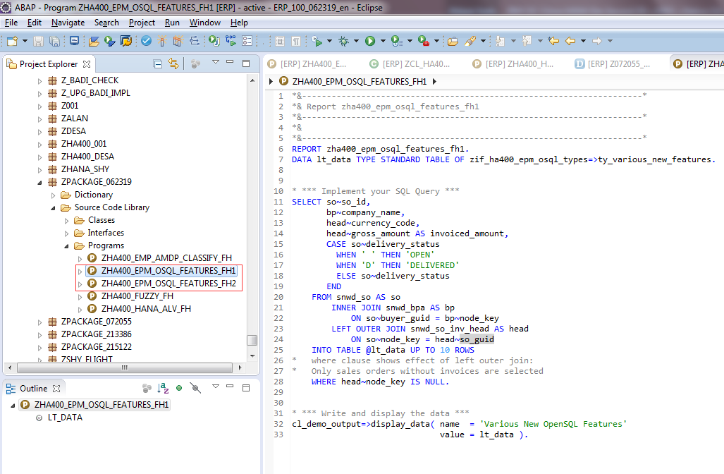
Exercise: New Open SQL

Slide 37

Time for Open Discussion
and Questions.

